Slide 1








St. Ann’s College of Engineering & Technology Department of CSE- AI&ML A Project Review on
Roadsy: Automated Traffic Sign Detection and Classification
Presented By:
CH. Paul Adarsh-2OFO1A4213
D. Shanmukha Sai-20F01A4216
M. Nikhil-20F01A4237
Under the Guidance of N. Ravi Teja-20F01A4239
Mrs. Sarada R. Sai Gopi-20F01A4248

Slide 2






TABLE OF CONTENTS
Abstract
Introduction
Objective of the project
Existing System
Drawbacks of Existing System
Proposed System
Advantages of Proposed System
Project Environment Specification
9. Conclusion

Slide 3






ABSTRACT
Traffic sign detection and classification is an important feature of advanced driver assistance systems, contributing to driver and autonomous cars safety as well as increasing driving comfort. In today's world, road conditions have improved significantly compared to previous decades. Obviously, the vehicle’s speed increases. Therefore, from the driver's perspective, they may ignore mandatory traffic signs when driving. Our model helps drivers recognize road signs to avoid road accidents, while also providing warnings to drivers and advanced driver assistance systems. We propose to use a convolutional neural network (CNN) algorithm to detect traffic signs in real-time training data. Our goal is to create an AI assistant that can instantly detect and classify signs, and display light warnings on the dashboard for driver control and ADAS. Our system leverages a deep learning model trained on traffic sign data to provide fast and accurate sign detection and classification based directly on drivers and ADAS. This ensures fewer accidents and also helps advanced driver assistance systems and drivers focus on driving rather than observing each traffic sign.

Slide 4


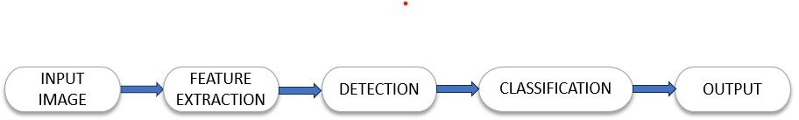

INTRODUCTION
Road Traffic have a specific rules are established by every government. Some of these rules are displayed to drivers by means of traffic signs that need to be
interpreted while driving. This may look as a simple task, but sometimes the driver misses signs, which may be problematic, eventually leading to car accidents. Although some drivers intentionally break the law, not respecting traffic signs, an automatic system able to detect these signs can be a useful help to most drivers.

Slide 5









OBJECTIVE OF THE PROJECT
Creating AI assistants to enhance advanced driver assistance systems (ADAS).
Real-time traffic sign recognition and classification.
High accuracy in detecting and reading traffic signs.
Capability to recognize signs in diverse conditions such as lighting, occlusion, and weather.

Slide 6
EXISTING SYSTEM
In previous approaches for developing traffic sign recognition models, three methods have been utilized.
K-means clustering: Based on similarities in the input data, this algorithm is used for clustering and partitioning data into groups or clusters. K-means clustering can be used to group similar features or patterns within traffic sign images, aiding in the detection and classification of signs in traffic sign recognition.
A combination of Lidar (Light Detection and Ranging) and vision-based techniques has been utilized.
Video streaming has been incorporated. It involves continuously capturing and analyzing video frames in real time, allowing for the sequential processing of visual data.

Slide 7

DRAWBACKS OF EXISTING SYSTEM
False Detection.
Redundancy (inter pixel redundancy).
Less efficiency and more response time.
Common problems include difficulty maintaining high accuracy in harsh conditions, difficulty recognizing different signs, and accuracy.

Slide 8





PROPOSED SYSTEM
Our proposed solution addresses the limitations of the existing system by leveraging convolutional neural networks (CNNs) for the robust detection and classification of traffic signs, specifically employing the YOLO (You Only Look Once) algorithm. This algorithm enables real-time detection and classification of traffic signs, contributing to enhanced accuracy. Our model is adept at processing real-time images in different environmental conditions.

Slide 9
ADVANTAGES OF PROPOSED SYSTEM
To reduce the chance of accidents.
To maintain good attention on the road while driving.
Provides output signals for vehicle systems to interpret and follow sign instructions.
Reducing the number of accidents caused by driver distraction and to reduce the seriousness of such accidents.
Improve the driver's safety on the road.

Slide 10

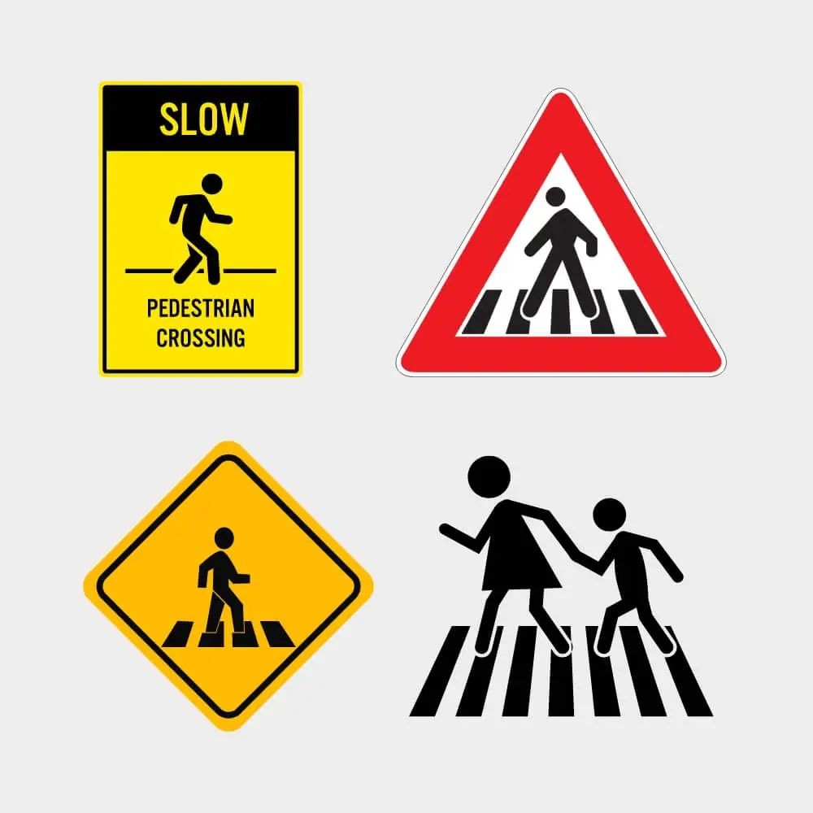

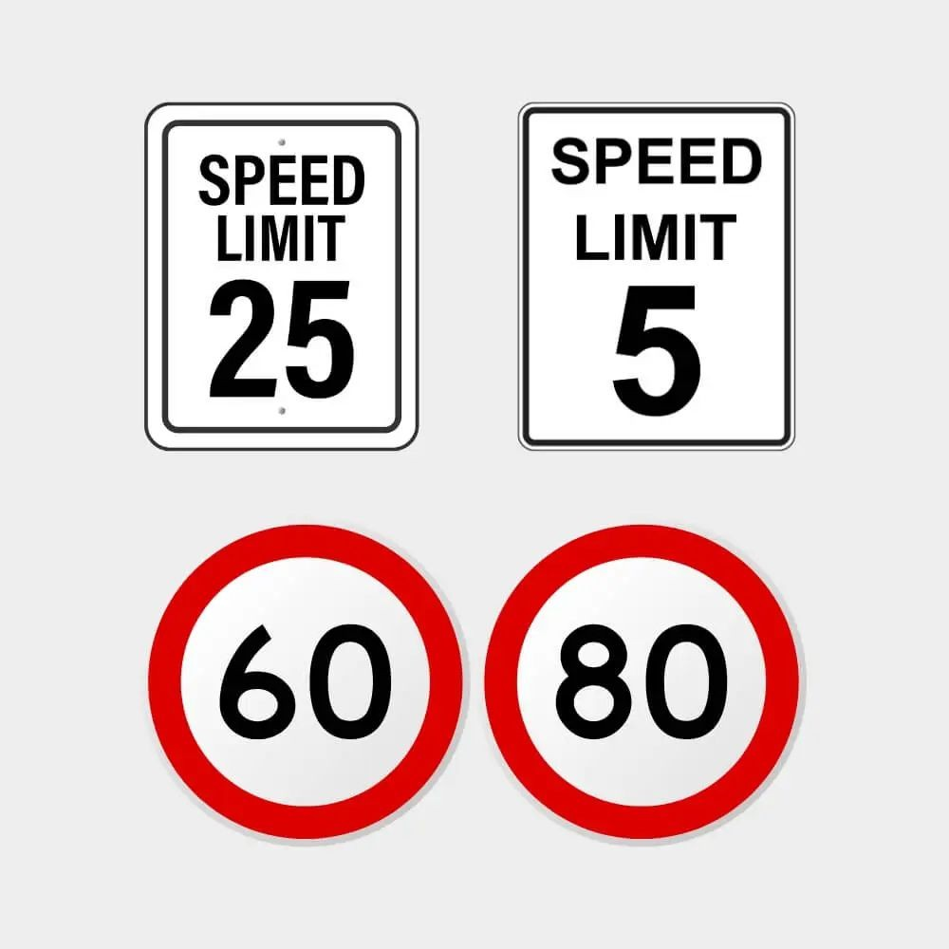

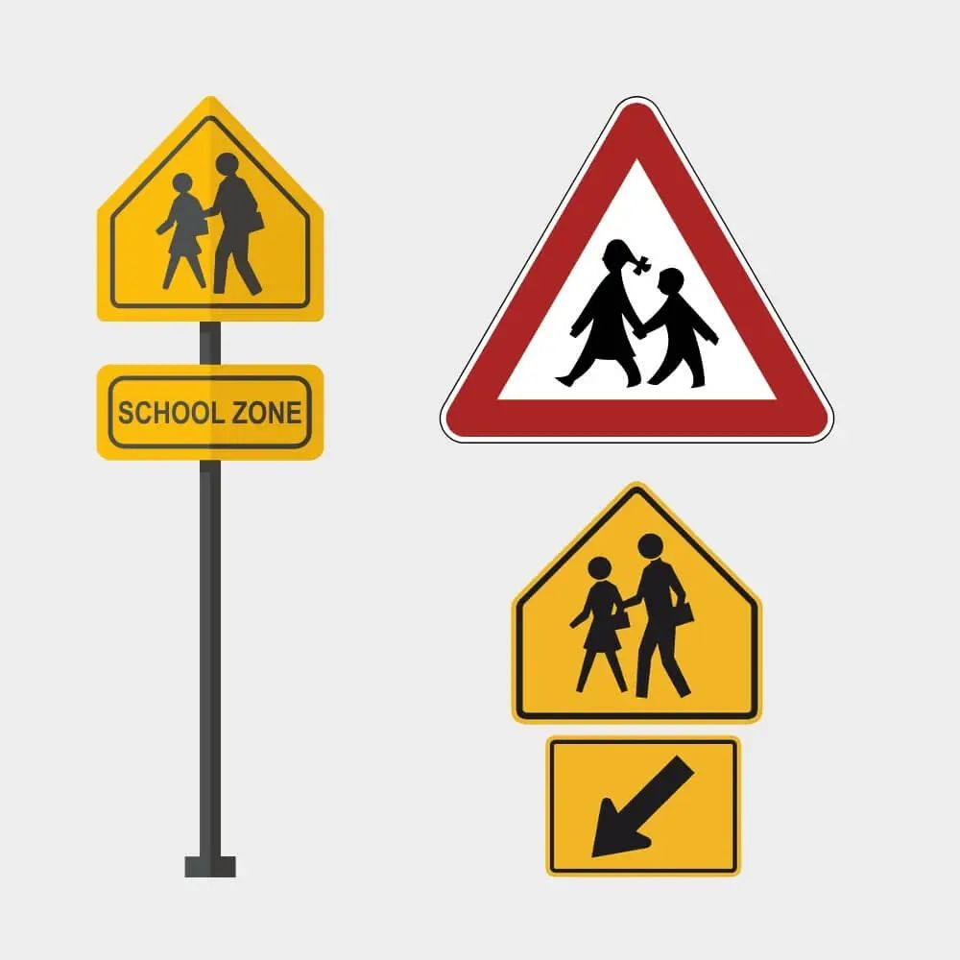
EXAMPLES

Slide 11
PROJECT ENVIRONMENT SPECIFICATION
HARDWARE REQUIREMENTS
System: i3 or i5 Processor HardDisk:256 GB.
Ram: 8 GB
SOFTWARE REQUIREMENTS
Operating system: Windows 10
Coding Language: Python
IDE : Jupyter Notebook
Tool: Streamlite, Visual Studio Code
Framework: Flask
Libraries: NumPy, Pandas, Beautiful Soup, OpenCV

Slide 12
CONCLUSION
The proposed model aims to advance Advanced Driver Assistance Systems (ADAS) towards autonomous cars. It relies on CNN for efficient sign detection based on color and shape, facing challenges like reflections impacting color and improper sign shapes. Night detection is an issue, especially with non-infrared webcams. To enhance safety, an AI Assistant is suggested to help drivers concentrate on driving instead of constantly checking traffic signs, reducing accidents both day and night.

Slide 13
THANK YOU

